Slide 1

Ddos attack detection of SDn Dataset using machine learning techniques & Classification Methods
Presented by:
Name
MSc
Reg. No.
University of East London

Slide 2
SUPERVISED BY:

Slide 3







AGENDA
Introduction
Background
Methodology
Implementation
Conclusion and Future Work
Results
EDA
3

Slide 4
1. Introduction
4

Slide 5
INTRODUCTION
Now-a-days cyber attacks have increased to a great extend. It is important to track down the attacks before it starts phishing on your machine.
Machine Learning (ML) provides us different algorithms which can help us to differentiate between malicious and benign request made from different websites online.
To differentiate between malicious and benign attacks, machine learning provides us different algorithms called as ‘classification algorithms’. These algorithms will be used in this paper to eliminate the problem and check out which algorithm will work for our dataset.
5
Notes:
Electronic health records (EHRs) are highly sensitive and private information related to the diagnosis and treatment of patient.
These information needs to be securely stored and frequently shared among different healthcare participants.
Improving the security and privacy of EHR systems and developing a scalable blockchain-based EHR solution is the main focus of my work described in this thesis.
In healthcare EHRs are the information related to the diagnosis and treatment of patient
Considered as highly sensitive and private information
Cancer, HIV patient long history (radiation dose)
As soon as this healthcare data become available over a network it becomes susceptible to eavesdropping and remote attacks.
EHRs are regular targets of both malicious attacks and misuse.
As sensitive and private - need to be securely store and frequently shared among participants
For EHRs the system must have good security and privacy of data

Slide 6
2. BACKGROUND
6

Slide 7
BACKGROUND
DDoS is the short form of "Distributed Denial of Service attack (DDoS)", and it is mostly used to attack the internet server to disturb the network traffic. With the help of this type of attack, attackers can change the site status on the server. With this kind of activity, a business site loses most of the revenue from its permanent clients. Attackers mostly attack those sites that are famous & popular among customers, such as e-commerce, e-learning, e-learning websites, and government-level site.
7
Notes:
Electronic health records (EHRs) are highly sensitive and private information related to the diagnosis and treatment of patient.
These information needs to be securely stored and frequently shared among different healthcare participants.
Improving the security and privacy of EHR systems and developing a scalable blockchain-based EHR solution is the main focus of my work described in this thesis.
In healthcare EHRs are the information related to the diagnosis and treatment of patient
Considered as highly sensitive and private information
Cancer, HIV patient long history (radiation dose)
As soon as this healthcare data become available over a network it becomes susceptible to eavesdropping and remote attacks.
EHRs are regular targets of both malicious attacks and misuse.
As sensitive and private - need to be securely store and frequently shared among participants
For EHRs the system must have good security and privacy of data

Slide 8
BACKGROUND
A group of developers, developed a machine learning model to detect whether an "SDN (Software-Defined Network) traffic is normal or DDoS attack traffic". For the model implementation, they have relayed on the classification algorithms such as "k-Nearest Neighbor (KNN), Decision Tree (DT), Artificial Neural Network (ANN), and Support Vector Machine (SVM)". According to this research study, the decision tree is the best approach under the binary classification problem to detect the DDoS attack.
8
Notes:
Electronic health records (EHRs) are highly sensitive and private information related to the diagnosis and treatment of patient.
These information needs to be securely stored and frequently shared among different healthcare participants.
Improving the security and privacy of EHR systems and developing a scalable blockchain-based EHR solution is the main focus of my work described in this thesis.
In healthcare EHRs are the information related to the diagnosis and treatment of patient
Considered as highly sensitive and private information
Cancer, HIV patient long history (radiation dose)
As soon as this healthcare data become available over a network it becomes susceptible to eavesdropping and remote attacks.
EHRs are regular targets of both malicious attacks and misuse.
As sensitive and private - need to be securely store and frequently shared among participants
For EHRs the system must have good security and privacy of data

Slide 9

3. Methodology
9

Slide 10
MODULES OF METHODOLOGY
Multi-Feature-based linear analysis has been performed in this work using various methods. In the first stage, data were obtained from Kaggle in its most basic form. Simple preprocessing techniques have been used to prepare the data. MinMax Scaler was used to standardize the remaining data. There is a training set of 70% and a testing set of 30% of the data that has been analyzed. Many machines learning models, such as Naïve Bayes (NB), Random Forest (RF), Logistic Regression (LR), K-Nearest Neighbor (KNN) have been trained and evaluated on 70% and 30% training sets, respectively.
10
Notes:
Improved security of electronic health records of patients
Protecting privacy of sensitive information
Enabling citizens to own and protect their data
More scalable solution compared to previously proposed blockchain-based EHR solutions.

Slide 11
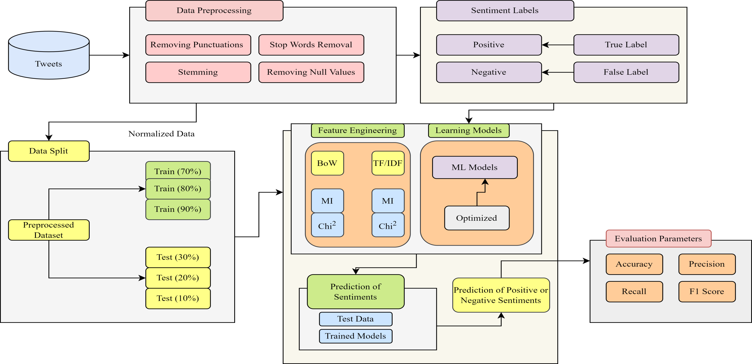
METHODOLOGY
11
Notes:
A smart contract is a self-executing contract with the terms of the agreement between parties.
This agreements exist across a distributed, decentralized blockchain network.

Slide 12
MODULES OF METHODOLOGY
Major steps & modules in the Research Methodology:
Dataset Description
Data Pre-Processing
Feature Engineering and Extraction Techniques
Data Splitting
Classification Models
Performance parameters
12
Notes:
Improved security of electronic health records of patients
Protecting privacy of sensitive information
Enabling citizens to own and protect their data
More scalable solution compared to previously proposed blockchain-based EHR solutions.

Slide 13
Dataset Description
I have also explored the dataset that can be used to implement the machine learning models, and this data is related to DDoS attacks. "DDoS DNS dataset" has been selected that consists of 23 attributes and 104345 observations or rows. It means there is a large database regarding DDoS attacks on different sites. Every observation is labelled as 1 or 0, '1' means there is a DDoS attack, and '0' means no DDoS attack. So, there are two classes against the 22 different information, so we can use binary classification to implement the approaches.
13
Notes:
Improved security of electronic health records of patients
Protecting privacy of sensitive information
Enabling citizens to own and protect their data
More scalable solution compared to previously proposed blockchain-based EHR solutions.

Slide 14
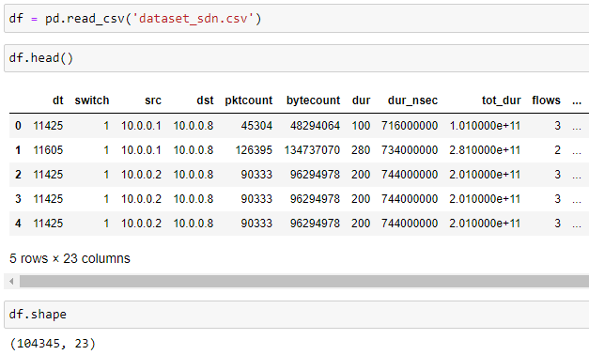
Dataset Description
14
Notes:
Improved security of electronic health records of patients
Protecting privacy of sensitive information
Enabling citizens to own and protect their data
More scalable solution compared to previously proposed blockchain-based EHR solutions.

Slide 15
4. Results and discussion
15

Slide 16
MODEL IMPLEMENTATION
Machine Learning Algorithms:
Support Vector Machine
Logistic Regression
K-Nearest Neighbors
Random Forest
Used four algorithms to compare results of the model
16
Notes:
Consensus Algorithm -
Hyperledger - practical byzantine fault tolerance
practical byzantine fault tolerance
PBFT- the ability of a distributed computer network to correctly reach a sufficient consensus despite malicious nodes in the system failing or sending out incorrect information.

Slide 17

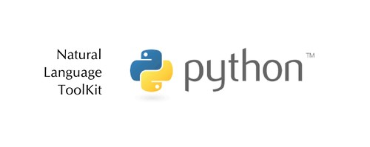


TOOLS & LANGUAGES
We have used Python language for the implementation
Following tools have been used:
17
Notes:
Hyperledger Composer is a set of collaboration tools for building blockchain business networks
AngularJS is a JavaScript-based open-source front-end web
composer-rest-server , to generate a REST API from a blockchain network that can be consumed by HTTP or REST clients

Slide 18
REQUIRED PACKAGES
Following packages required for implementation:
Packages Names
matplotlib
seaborn
Sklearn.preprocessing
Sklearn.metrics
Sklearn.enesmble
Packages Names
pandas
numpy
Sklearn.linear_model
Sklearn.naive_bayes
Sklearn.neighbors
18
Notes:
Linux Foundation, and has received contributions from IBM
By default Kafka is the Hyperledger Fabric ordering mechanism required to establish total order of transactions.
It collects transactions from the clients, order them and group them into a blocks chained one after another.
Certificate authorities (CAs) handle identity registration and digital certificates for Fabric networks .
Entities communicating in the network identify themselves using certificates issued by one of the CAs in the network.
The entities validating the certificates are the MSPs
Modular: an approach that subdivides a system into smaller parts
TLS: Transport Layer Security

Slide 19
5. EDA (Exploratory Data Analysis)
19

Slide 20
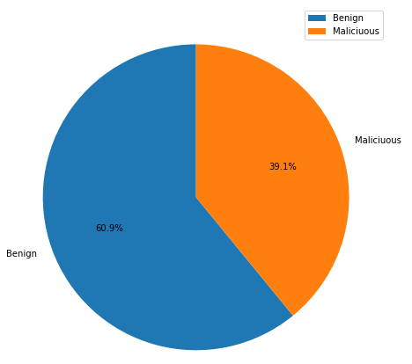
Pie Chart Representation
Figure shows the request being made on the observed server from different sources. Most of the requests are ignorable 60.9%, but also a huge amount of requests 39.1% made are Malicious which are important to track down.
20
Notes:
Linux Foundation, and has received contributions from IBM
By default Kafka is the Hyperledger Fabric ordering mechanism required to establish total order of transactions.
It collects transactions from the clients, order them and group them into a blocks chained one after another.
Certificate authorities (CAs) handle identity registration and digital certificates for Fabric networks .
Entities communicating in the network identify themselves using certificates issued by one of the CAs in the network.
The entities validating the certificates are the MSPs
Modular: an approach that subdivides a system into smaller parts
TLS: Transport Layer Security

Slide 21
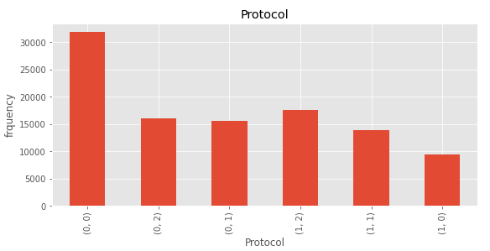
Bar Chart Representation
This figure show different protocols from which the request was made. From this observe that most requests are made from ‘ICMP’ 0, then from ‘UDP’ 2 and at the last from ‘TCP’ 1.
21
Notes:
Linux Foundation, and has received contributions from IBM
By default Kafka is the Hyperledger Fabric ordering mechanism required to establish total order of transactions.
It collects transactions from the clients, order them and group them into a blocks chained one after another.
Certificate authorities (CAs) handle identity registration and digital certificates for Fabric networks .
Entities communicating in the network identify themselves using certificates issued by one of the CAs in the network.
The entities validating the certificates are the MSPs
Modular: an approach that subdivides a system into smaller parts
TLS: Transport Layer Security

Slide 22
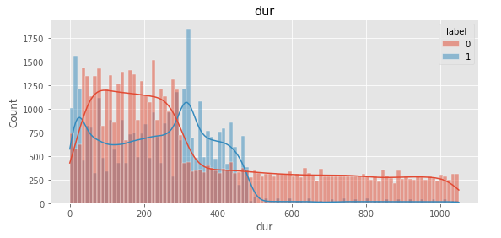
Duration
It shows that the duration required for a malicious attack falls between 0 to 500. however most of the attacks are made in between 300 to 500. Benign request durations are high then malicious.
22
Notes:
Linux Foundation, and has received contributions from IBM
By default Kafka is the Hyperledger Fabric ordering mechanism required to establish total order of transactions.
It collects transactions from the clients, order them and group them into a blocks chained one after another.
Certificate authorities (CAs) handle identity registration and digital certificates for Fabric networks .
Entities communicating in the network identify themselves using certificates issued by one of the CAs in the network.
The entities validating the certificates are the MSPs
Modular: an approach that subdivides a system into smaller parts
TLS: Transport Layer Security

Slide 23
6. Results
23

Slide 24
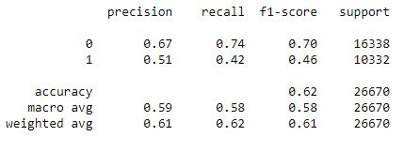
LR FINDINGS
By applying the Logistic Regression algorithm on the dataset we obtain that the precision for the detection of benign requests is 67%. And that of malicious requests is 51%. With the overall accuracy of 62% which is much lower a satisfying detection system .
24

Slide 25
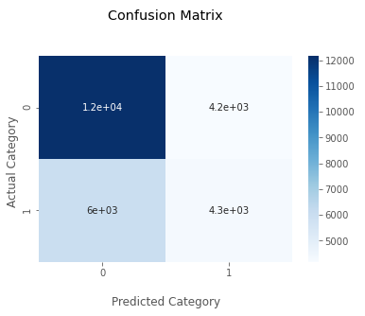
LR FINDINGS
From the confusion matrix, we observed that Logistic Regression has badly failed the predictions. As among the requests that were malicious it has predicted 6000 of them as benign. Similarly, it has 4200 wrong predictions for the benign requests.
25

Slide 26
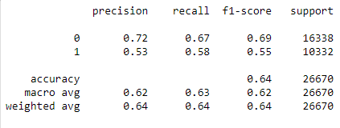
NB FINDINGS
By applying the Naïve Bayes algorithm on the dataset we observe that the precision for the detection of malicious requests is 53%, which is much more lower than the precision of the detection of benign requests which is 72%. However the overall precision of NB is 64%, which is better than LR, but still we need a better algorithm.
26

Slide 27
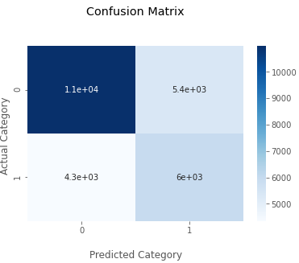
NB FINDINGS
From the confusion matrix, we observed that NB has failed the predictions. As among the requests that were benign it has predicted 5400 malicious. It has failed the predictions but is better than Logistic Regression.
27

Slide 28
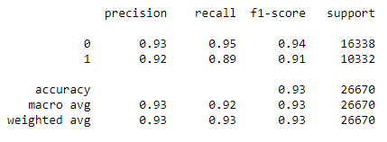
KNN FINDINGS
By applying the KNN algorithm we have achieved the precision for the benign request to 93% and that of malicious is 92%. This is much more better than the LR and NB, as it provides the overall accuracy of 93% which is much more higher than the algorithms applied before.
28

Slide 29
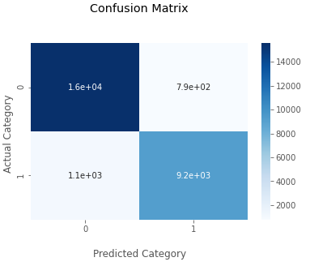
KNN FINDINGS
From the total of 26670 requests it has predicted most of them as they were. There are wrong predictions but they are not much, which means that by using some hyper tuning we can cover that also. But rather than hyper tuning we will go for the ensemble algorithm.
29

Slide 30
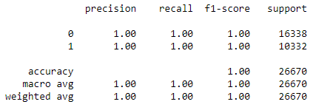
RF FINDINGS
By applying the Random Forest algorithm on the dataset we observe that the ensemble algorithm has given the best result. Random Forest has the overall precision of 100% which is extraordinary and has proved to be the best model for the prediction of ddoos attack.
30

Slide 31
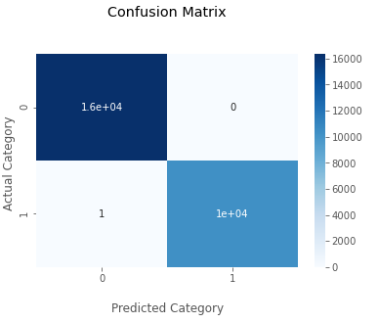
RF FINDINGS
From the total of 26670 requests it has predicted all of them as they were, except for one which was malicious but the algorithm has predicted it as benign. But one wrong prediction is absolutely ignorable.
31

Slide 32
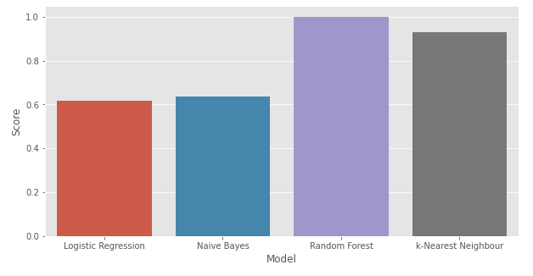
COMPARISON RESULTS
This table shows the comparison between each algorithm according their metrics. Among them Random Forest has highest accuracy, precision, recall and F1-score. LR and NB are proved to be the worst in this scenario and KNN stands at the center with the accuracy of 93%.
32

Slide 33
RESULTS DISCUSSION
We used Logistic Regression, Naive Bayes, KNN, Random Forests to analyze a dataset of DDOS attacks. The dataset had previously been preprocessed for various models. Feature extraction and Exploratory Data Analysis has been performed on the data to understand the data more deeply. Our proposed pipeline design performs in terms of accuracy, precision, recall, and F1. The results achieved with these models are presented above in confusion matrix. And the accuracy are for LR is 62%, the accuracy of Naïve Bayes is 64%, the accuracy of KNN is 93% and the accuracy of Random Forest is 99.99%.
Even though the data are evenly distributed, NB may provide sub-optimal models due to data imbalances. The use of KNN cannot directly support an uneven categorization because of their inherent assumptions. If the data are skewed, the training method for the KNN model must be altered by utilizing hyper-tuned models.
33
Notes:
Electronic health records (EHRs) are highly sensitive and private information related to the diagnosis and treatment of patient.
These information needs to be securely stored and frequently shared among different healthcare participants.
Improving the security and privacy of EHR systems and developing a scalable blockchain-based EHR solution is the main focus of my work described in this thesis.
In healthcare EHRs are the information related to the diagnosis and treatment of patient
Considered as highly sensitive and private information
Cancer, HIV patient long history (radiation dose)
As soon as this healthcare data become available over a network it becomes susceptible to eavesdropping and remote attacks.
EHRs are regular targets of both malicious attacks and misuse.
As sensitive and private - need to be securely store and frequently shared among participants
For EHRs the system must have good security and privacy of data

Slide 34

8. CONCLUSION & FUTURE WORK
34

Slide 35
CONCLUDING STATEMENT
The findings of this study led the researchers to conclude that the most productive tactic would be to evaluate machine learning models using imbalanced data.
It is possible to enhance the accuracy, precision, and recall, as well as the f1 Score, by comparing the outcomes of the many different feature extractors, feature selections, hyper-tuned parameters, and so on.
We used the information to calculate our potential pipeline's F1 Score and other indicators. We used LR, Naïve Bayes, KNN, Random Forests to analyze a dataset of DDOS attack with default parameters.
The results achieved with Naïve Bayes has 64% accuracy. The accuracy achieved with k-nearest neighbor is 93%.
35
Notes:
The thesis presents a cost effective and adaptable blockchain solution for improving security, privacy and scalability of EHR systems.
The proposed blockchain-based EHR framework has been successfully implemented in Hyperledger Fabric.
The implementation is verified to work according to the description provided in this thesis and it can be concluded that the framework can draw benefits from an implementation in Hyperledger Fabric.

Slide 36
FUTURE WORK
To further improve this research work, some new features and techniques can be benefited like:
When dealing with the lack of balance data sets the KNN should not be used.
To have more better results there is a strong need to implement more authentic models.
Try to build the models which can provide better results with the less featured weighted dataset and reduce the uncertainty as well.
Use the perfect deep learning models to have better results.
Develop GUI based dashboard for visualizations to make it user friendly.
36
Notes:
Currently the there is no secure mechanisms to share keys with user
Implementing these features should be the next step in any further development of the package.

Slide 37
Thank You
37

